Slide 1
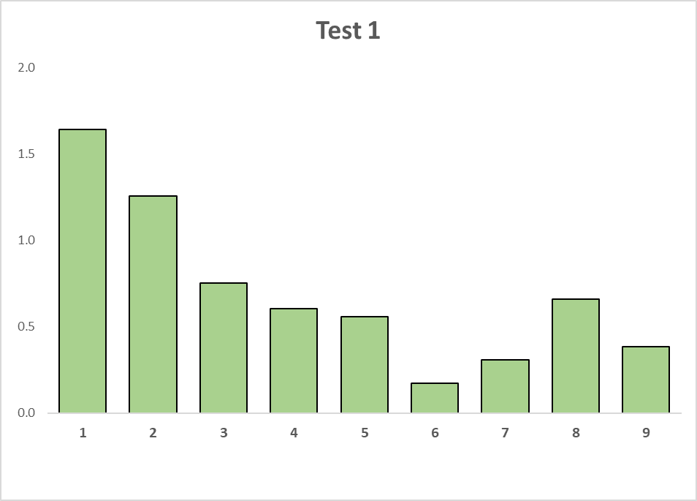
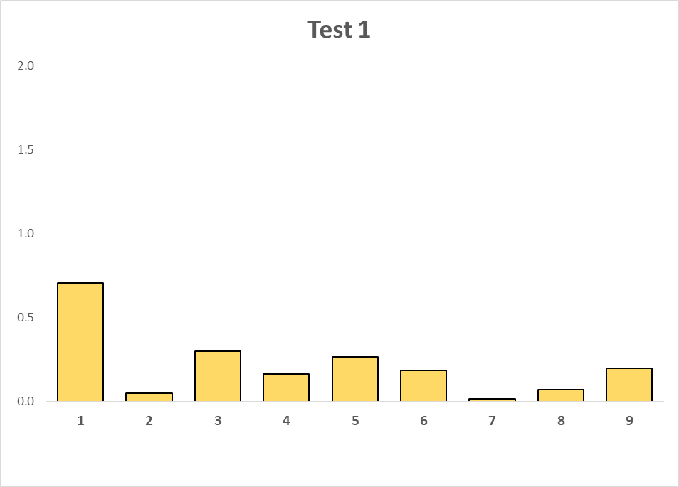
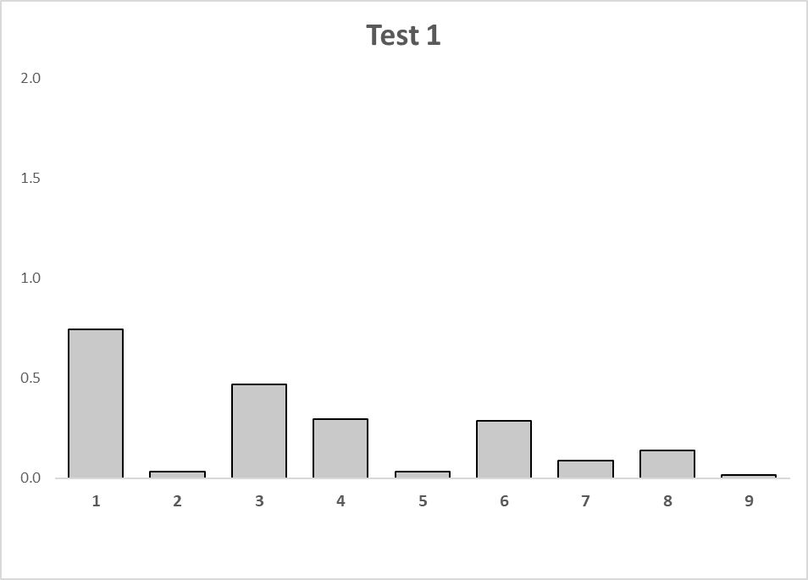
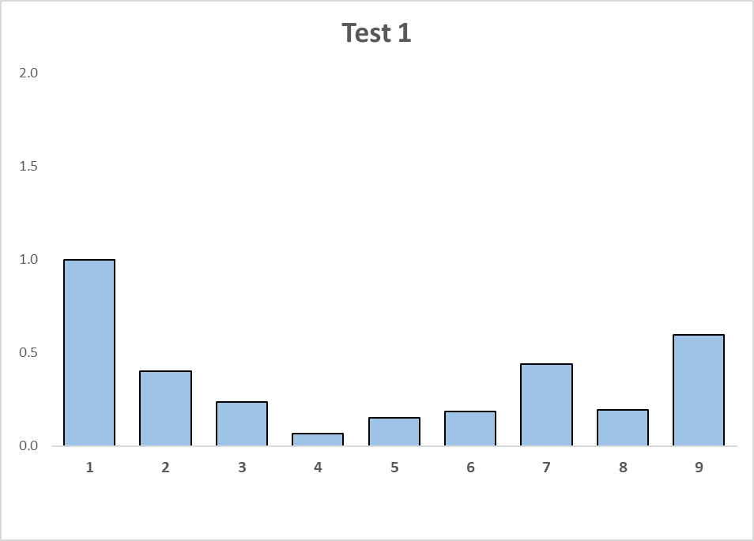
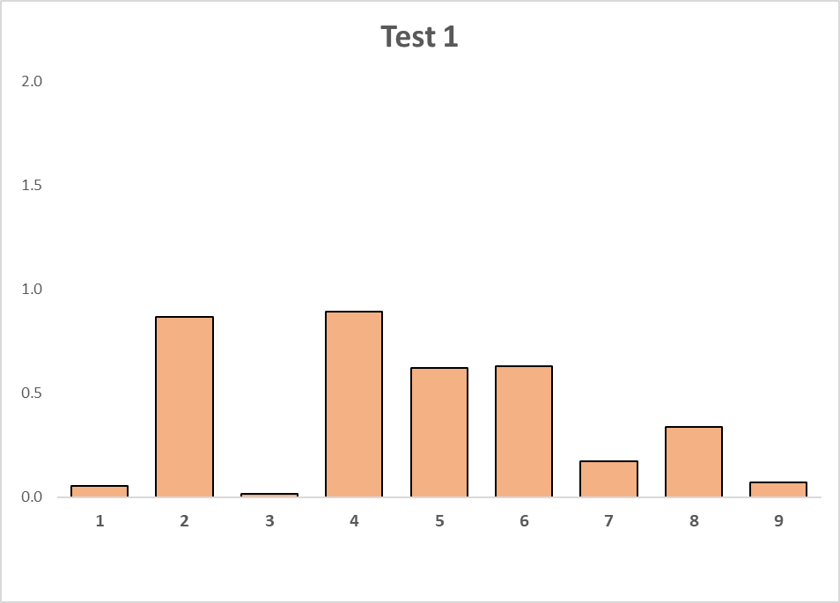
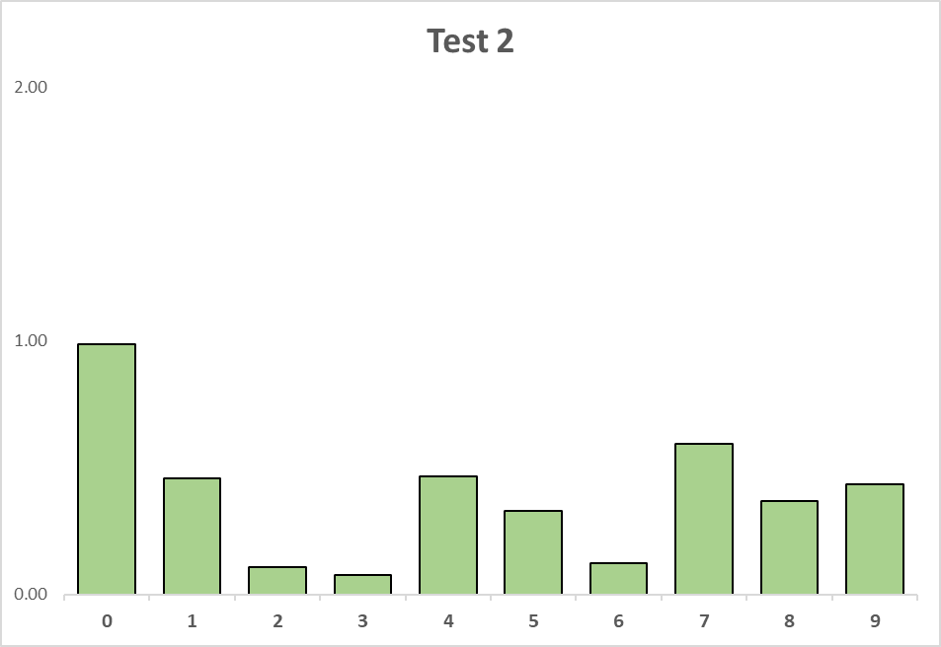
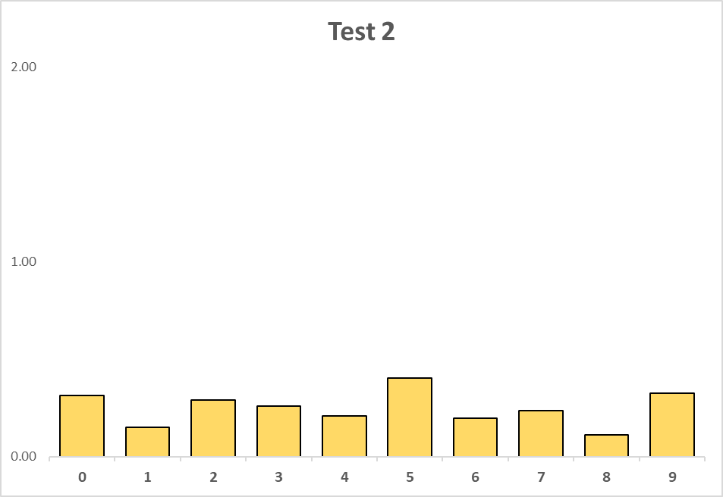
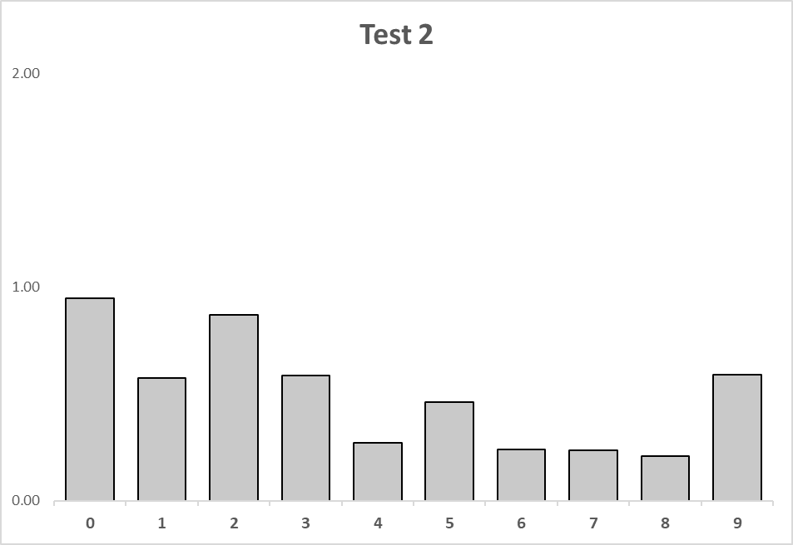
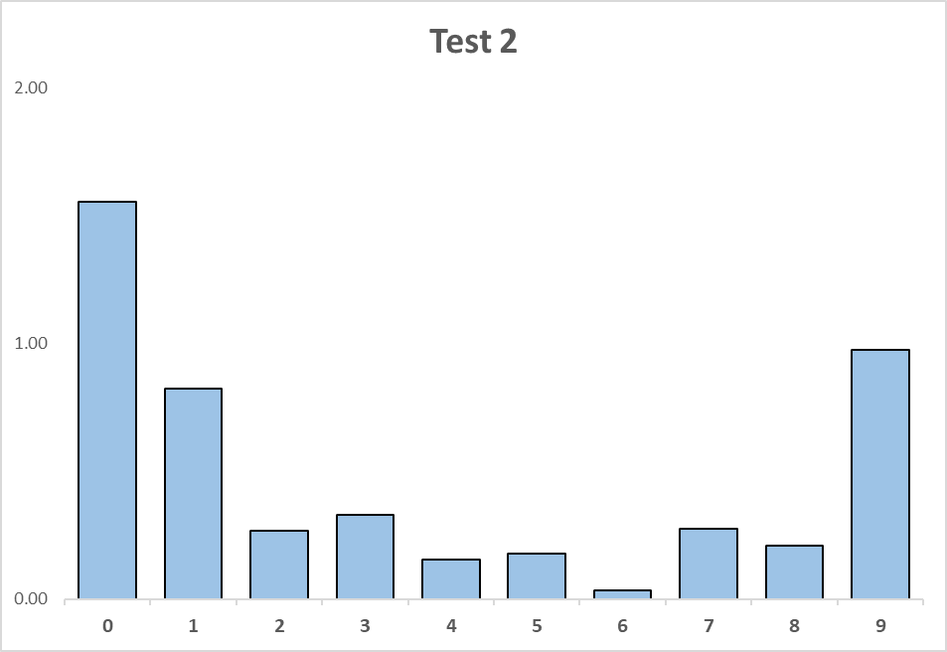
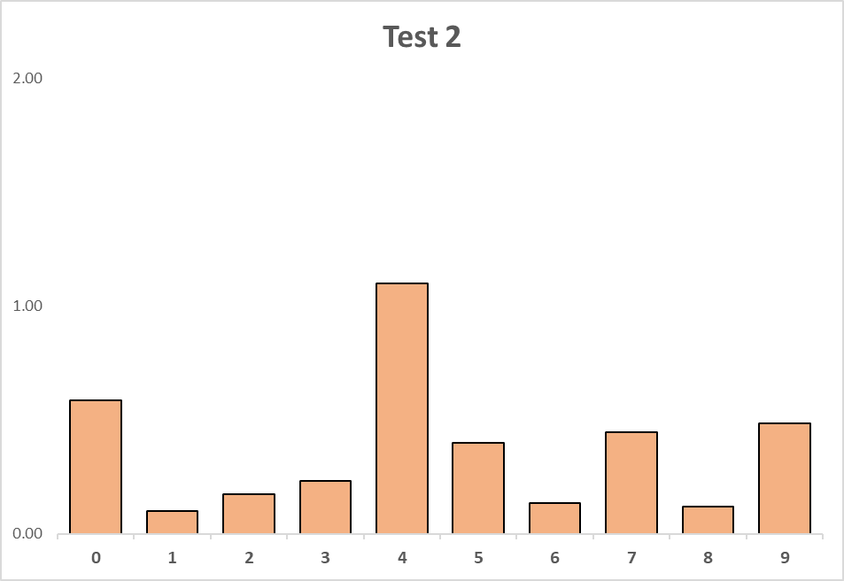
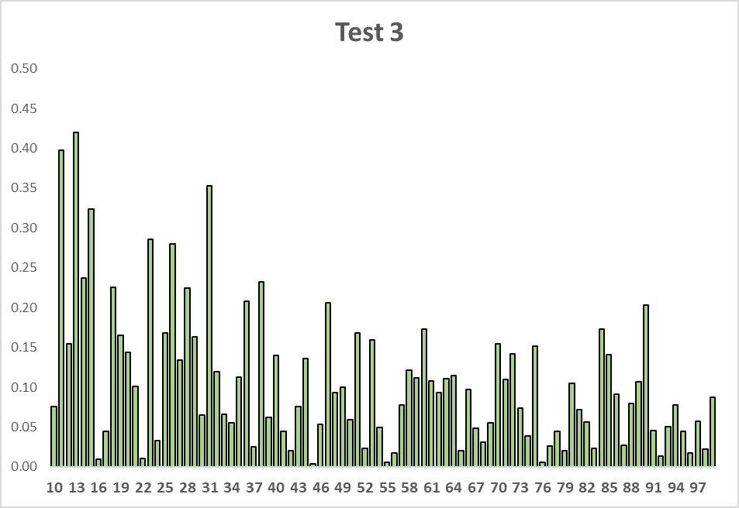
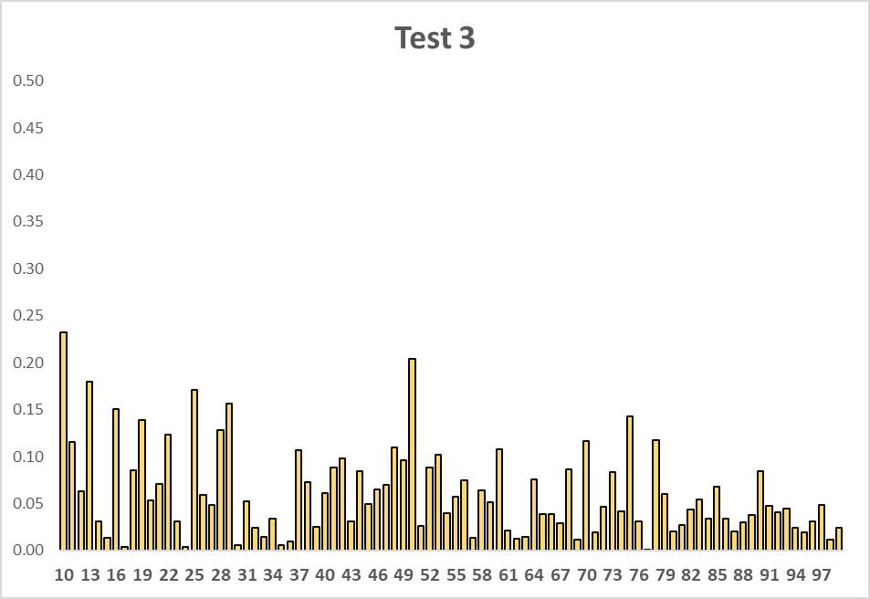
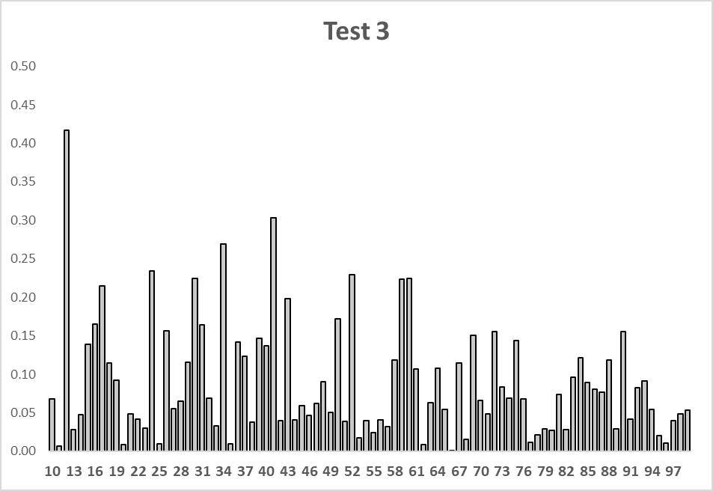
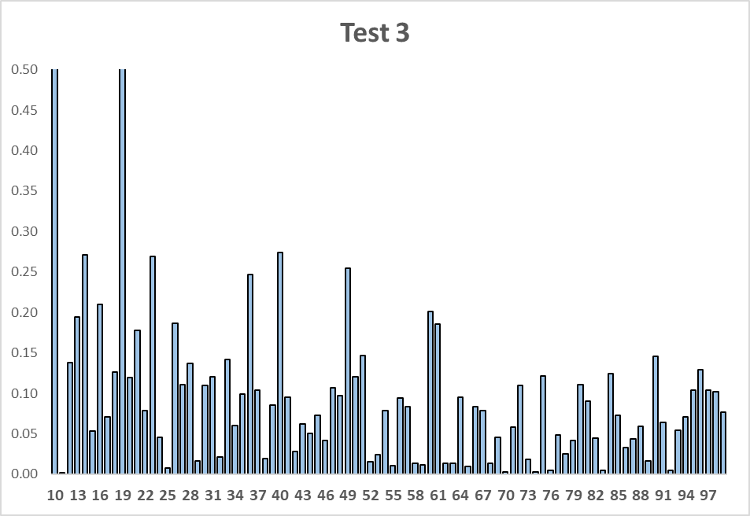
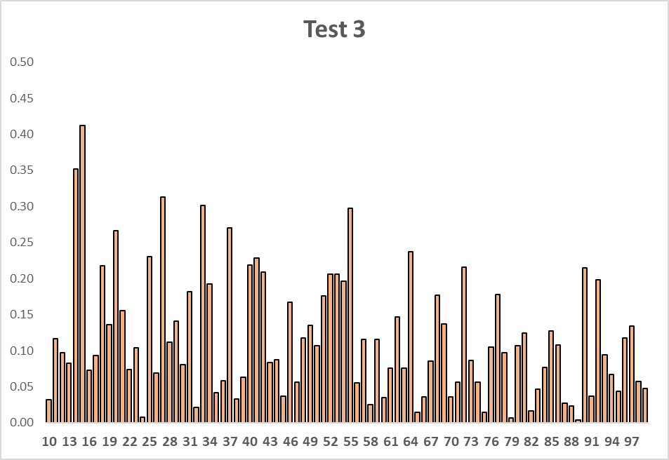




















N= 18,599
$D^{+}$=0.01644
$D^{−}$=0.01522
$V_{N}^{∗}$= 4.322
N= 29,609
$D^{+}$=0.00270
$D^{−}$=0.00707
$V_{N}^{∗}$= 1.683
N= 21,707
$D^{+}$=0.00773
$D^{−}$=0.00241
$V_{N}^{∗}$= 1.496
N= 11,831
$D^{+}$=0.00996
$D^{−}$=0.00035
$V_{N}^{∗}$= 1.123
N= 9,932
$D^{+}$=0.01828
$D^{−}$=0.0000
$V_{N}^{∗}$= 1.824
N= 18,599
$D^{+}$=0.01510
$D^{−}$=0.00010
$V_{N}^{∗}$= 2.075
N= 29,609
$D^{+}$=0.00456
$D^{−}$=0.00015
$V_{N}^{∗}$= 0.811
N= 21,707
$D^{+}$=0.01246
$D^{−}$=0.00010
$V_{N}^{∗}$= 1.852
N= 11,831
$D^{+}$=0.01554
$D^{−}$=0.00010
$V_{N}^{∗}$= 1.703
N= 9,932
$D^{+}$=0.00743
$D^{−}$=0.00355
$V_{N}^{∗}$= 1.096
N= 18,599
$D^{+}$=0.01799
$D^{−}$=0.01570
$V_{N}^{∗}$= 4.600
N= 29,609
$D^{+}$=0.00393
$D^{−}$=0.00770
$V_{N}^{∗}$= 2.00
N= 21,707
$D^{+}$=0.01035
$D^{−}$=0.00231
$V_{N}^{∗}$= 1.868
N= 11,831
$D^{+}$=0.01509
$D^{−}$=0.00046
$V_{N}^{∗}$= 1.693
N= 9,932
$D^{+}$=0.01960
$D^{−}$=0.00280
$V_{N}^{∗}$= 2.236

